Slide 1
Big Mountain Resort
Ticket Price Analysis

Slide 2
How to decide the ticket price by either cutting costs without undermining the ticket price or by capitalizing the facilities to support a higher ticket price?
1 Context
Big Mountain Resort installed an additional chair lift leaded to an increase in the operation cost. The operation team would want to determine the ticket price by either cutting other costs to remain the price or better utilizing the facilities to support higher ticket prices in the next season.
2 Criteria for success
Determine the ticket price that could give the best value before the start of next season.
3 Scope of solution space
Reduce unnecessary expenses to cut the cost or improve existing facilities to profit more compared to other resorts
4 Constraints within solution space
Setting ticket price at the market average doesn’t provide a good sense of how important some facilities are compared to others.
Operating Costs for facilities are unknown.
5 Stakeholders to provide key insight
Jimmy Blackburn - Director of Operations
Alesha Eisen - Database Manager
6 Key data sources
CSV file from database manager: This includes a list of operating information from 330 resorts in the US that can be considered part of the same market share including Big Mountain Resort itself.

Slide 3
Recommendation and key findings
The ticket price for Big Mountain Resort has potential to be increased.
Current ticket price: $81
Model predicted ticket price: $95.87 (± $10.39 mean absolute error)
Key features affecting ticket price:
Vertical drop
Number of runs
Number of fastQuads
Snow making area

Slide 4
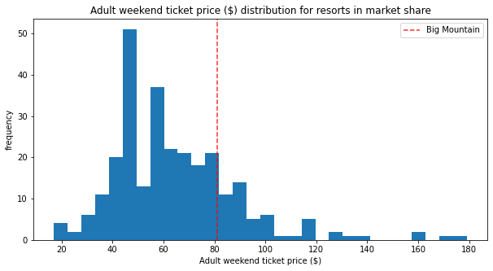
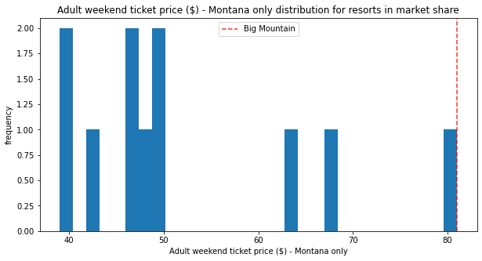
Modeling results and analysis
Currently, Big Mountain Resort has the highest ticket price in Montana State.
The price is also higher than most of the resorts in market share.

Slide 5
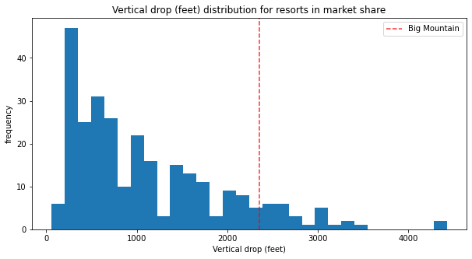
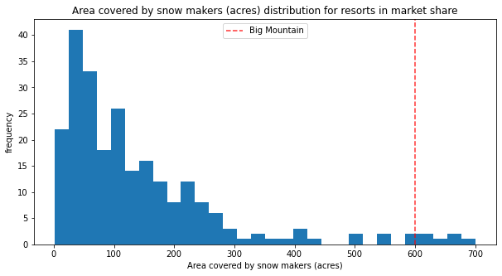
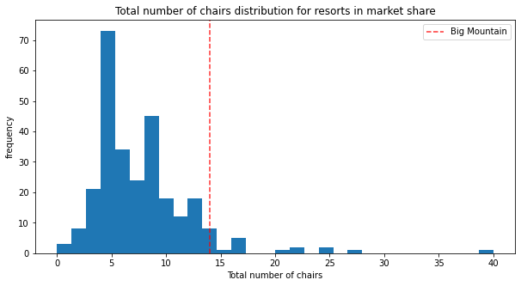
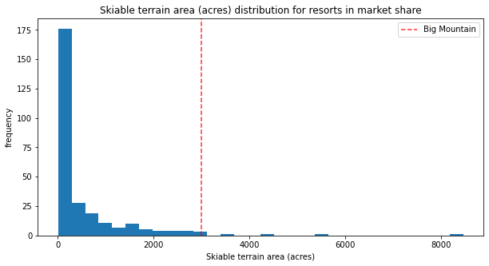
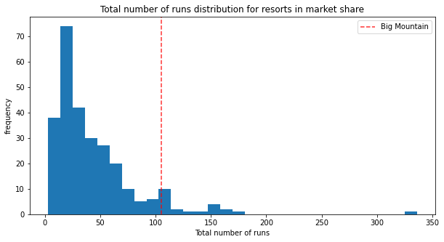
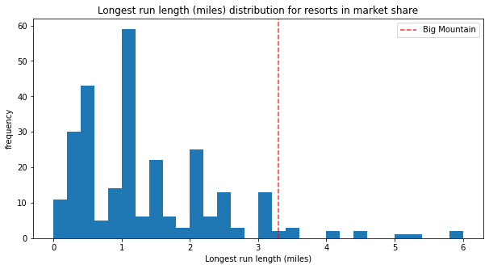
Modeling results and analysis
Big mountain compares well amongst all resorts for important features affecting ticket price.
It suggests that a higher ticket price for Big Mountain Resort is reasonable.

Slide 6
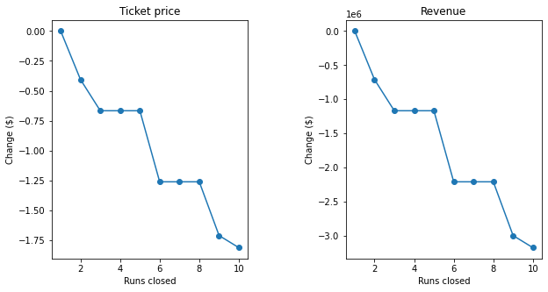
Modeling results and analysis
Results of 4 different scenarios:
Permanently closing down up to 10 of the least used runs:
Closing off 1 run has no effect on ticket price. If closing off 10 least used runs, it will lower the predicted price by $1.81.
Increase the vertical drop by 150 feet, install an additional chair lift and adding a run:
The ticket price went up by $1.99.
Same as number above, but adding 2 acres of snow making cover:
The ticket price went up by $1.99.
Increase the longest run by 0.2 mile to boast 3.5 miles length, requiring an additional snow making coverage of 4 acres:
No effect to the predicted price

Slide 7
Summary and conclusion
Current arrangement of facilities of Big Mountain could support higher ticket prices.
Focus more on vertical drop, number of runs, number of fastQuads and snow making area to further reduce the operating cost or improve existing facilities

